Slide 1

Technical Analysis
Presentation by- Dr. Naresh Chandra Sahu
Associate Professor of Economics
IIT Bhubaneswar

Slide 2
Technical Analysis
Technical analysis is based on the premise that “history repeats itself” and hence movement in stock prices follow an established trend which can be gauged from past price and volume data.
As per Technical Analysis future price behaviour can be predicted on the basis of past price analysis.
Technical analysis involves the study of various charts, ratios and patterns to predict future direction of stock prices.
It helps in answering the questions like “Is it the right time to buy a share?” or “Is it the right time to sell a share?”
Hence once it is decided to invest in the shares of a particular company, the right timing of investment can be decided on the basis of technical analysis.

Slide 3
Introduction
Market analysis is broadly categorized into two main methods,
Fundamental analysis
Technical analysis.
In fundamental analysis an analyst needs to look at the financial statements of a company, its business model, overall macro-economic scenarios, management capabilities and many more things for coming to a specific fair value of a company.

Slide 4
Introduction
A technical analyst only looks at price of a stock derived as a result of supply-demand interaction.
For a technical analysts, price is supreme and he or she sees price as manifestation of every fundamental reality.
Hence, they look only at two main aspects in the market. Price -over -time and volume.
The entire discipline of technical analysis is based on these two data points, price over time and volume.

Slide 5
Introduction
All patterns, indicators, concepts are derived from these two basic data points.
This is not a definitive science, rather a probabilistic discipline.
In simple terms, it is more of an art than science.
There are well known chart patterns or indicators in the market.
But nothing works 100% of time. That is why it is called an art.
With experience, a chartist is able to form an opinion of his or her own so that he has some extra edge on the market assessment than someone having just bookish knowledge of technical analysis.

Slide 6
Fundamental Vs. Technical Analysis
Basis | Fundamental Analysis | Technical Analysis
Objective | To determine intrinsic value | To determine future trend
Source of information | EIC Analysis, Govt reports, Company Financial Statements | Past price and volume
Tools and techniques | EIC analysis, ratio analysis, discounted cashflow analysis etc. | Trend analysis and Chart patterns
Time horizon | Long term | Short term
Who uses | Investors | Traders
Investment Decision | Buy: when intrinsic value > market value Sell: When Intrinsic value < market value | Based on price movements

Slide 7
Tools of Technical Analysis
Technical analysis can be performed both at the market level and at individual company level using various types of charts, ratios, patterns or indicators. Some of these are:
Charts Analysis
Trend Analysis
Market Indicators
Volume Analysis

Slide 8
Charts and Its Types
Charts are two-dimensional representation of price over time.
There are many types of charts available.
Line Charts, Bar Charts and the Candlestick Charts.
The unit can be month, week, day, hour, 5 min or few seconds.
The shorter the time period, more detailed the chart becomes.
The beauty of time in technical analysis is that the same concepts apply to charts irrespective of time-frame of observation.
Generally higher the time frame of chart, relatively higher is the probability of any concept in market.

Slide 9
Line Chart
In line chart each and every price point is represented as a dot.
The X-axis represents the time scale and the Y-axis represents the price.
Each dot or point represents the closing price at the end of a unit of time.
These points are then joined to form a line.
This is the simplest form of chart.
But this is quite good if we want to plot 3-4 similarly priced stocks in a single chart and compare.
Moreover, the line chart gives the clearest idea about price direction of a stock.

Slide 10
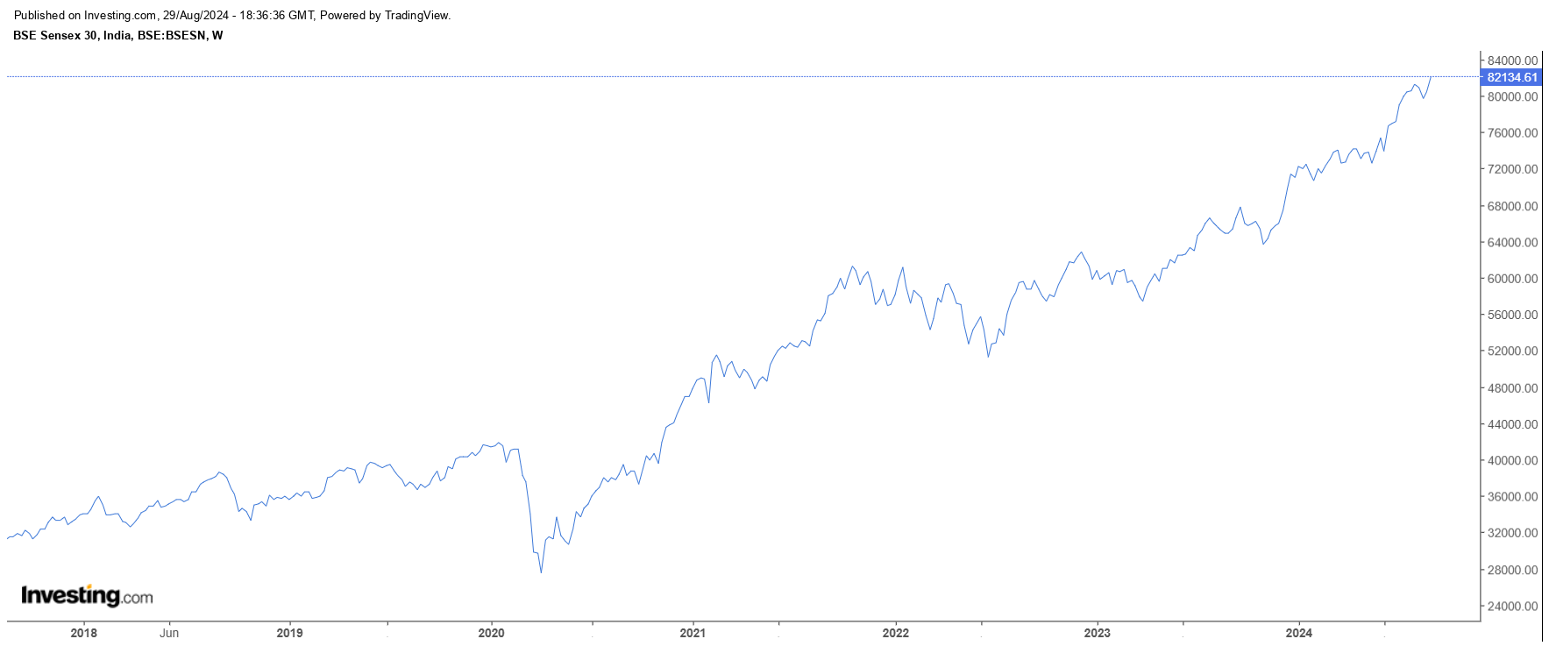
Line Chart

Slide 11
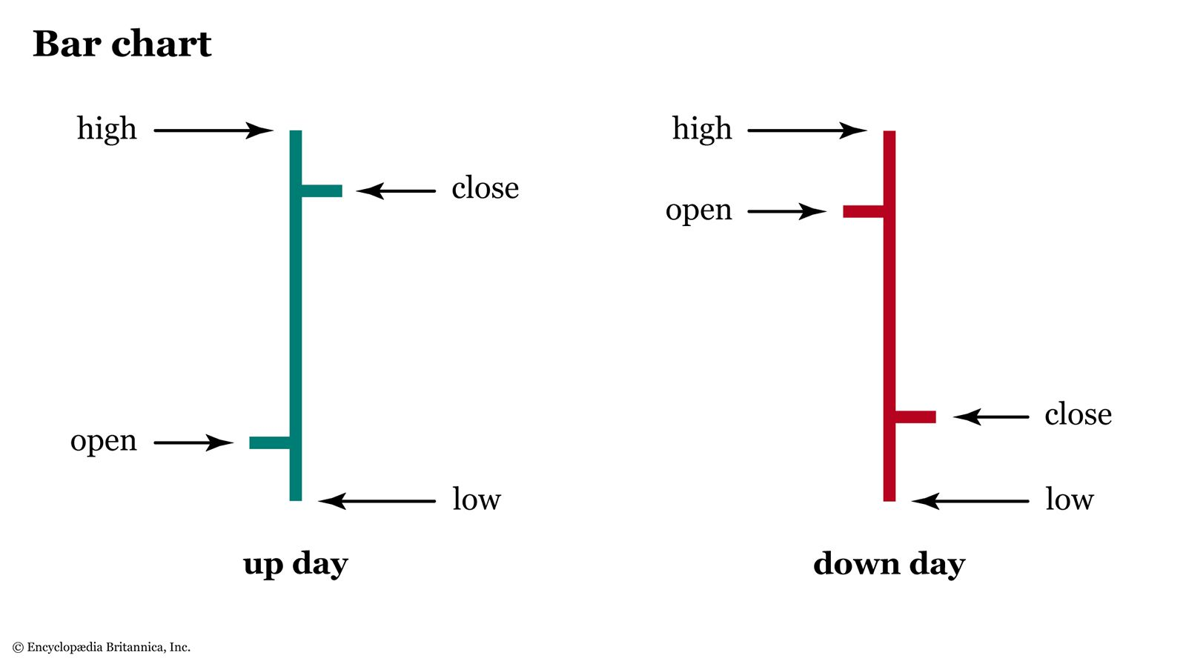
Bar Chart
A bar chart is comprised of a series of bars.
Every bar has four important price points - open close high and low.
The bars are represented in green or blue color when close is higher than open and red color when close is lower than open.
The bar charts are more detailed than the line chart and are good for demonstrating or spotting the classical price patterns.

Slide 12
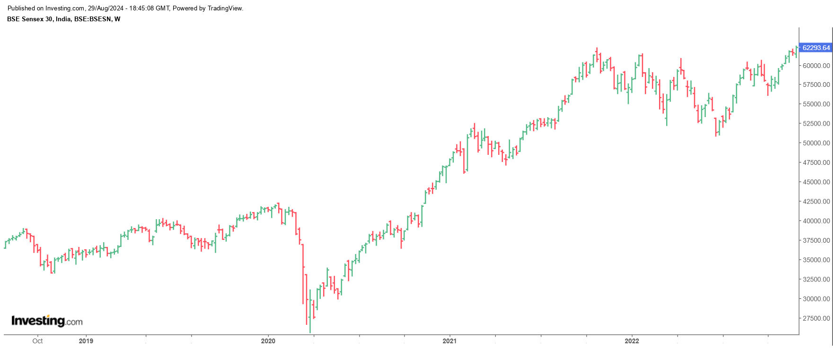
Bar Chart

Slide 13
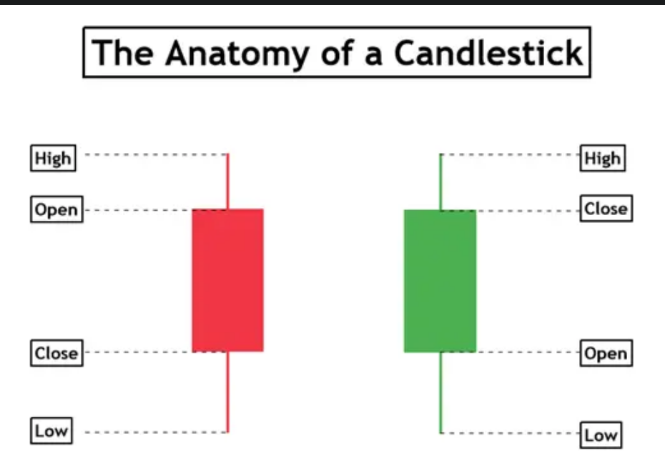
Candlestick Chart
The concept of candlestick charts came from Japan.
These charts are the most versatile and popular form of chart representation. Price behavior during each time unit is represented in the form of a candle.
If the closing price of a stock is higher than open price during a particular time period, then the candle is green, if the close price is below the open price then the candle is red.
Each candle has a body and two wicks.
The distance between open to close is represented by the body of a candle and the upper and lower wicks represent the highs and lows of a candle.

Slide 14
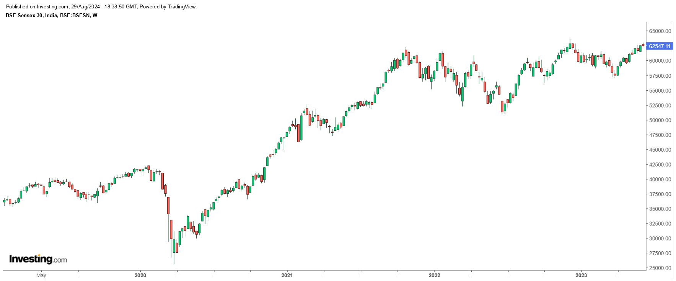
Candlestick Chart

Slide 15
Trend
Market movements happen in the form of trends.
A price trend is a continuous or a directional price movement in upward or downward direction. We call them up-trend and down-trend respectively.
Nothing moves straight up for long, so there will always be oscillations, but the overall direction needs to be in the same direction to be considered in a trend.
Types:
Uptrend
Downtrend
Sideways trend

Slide 16
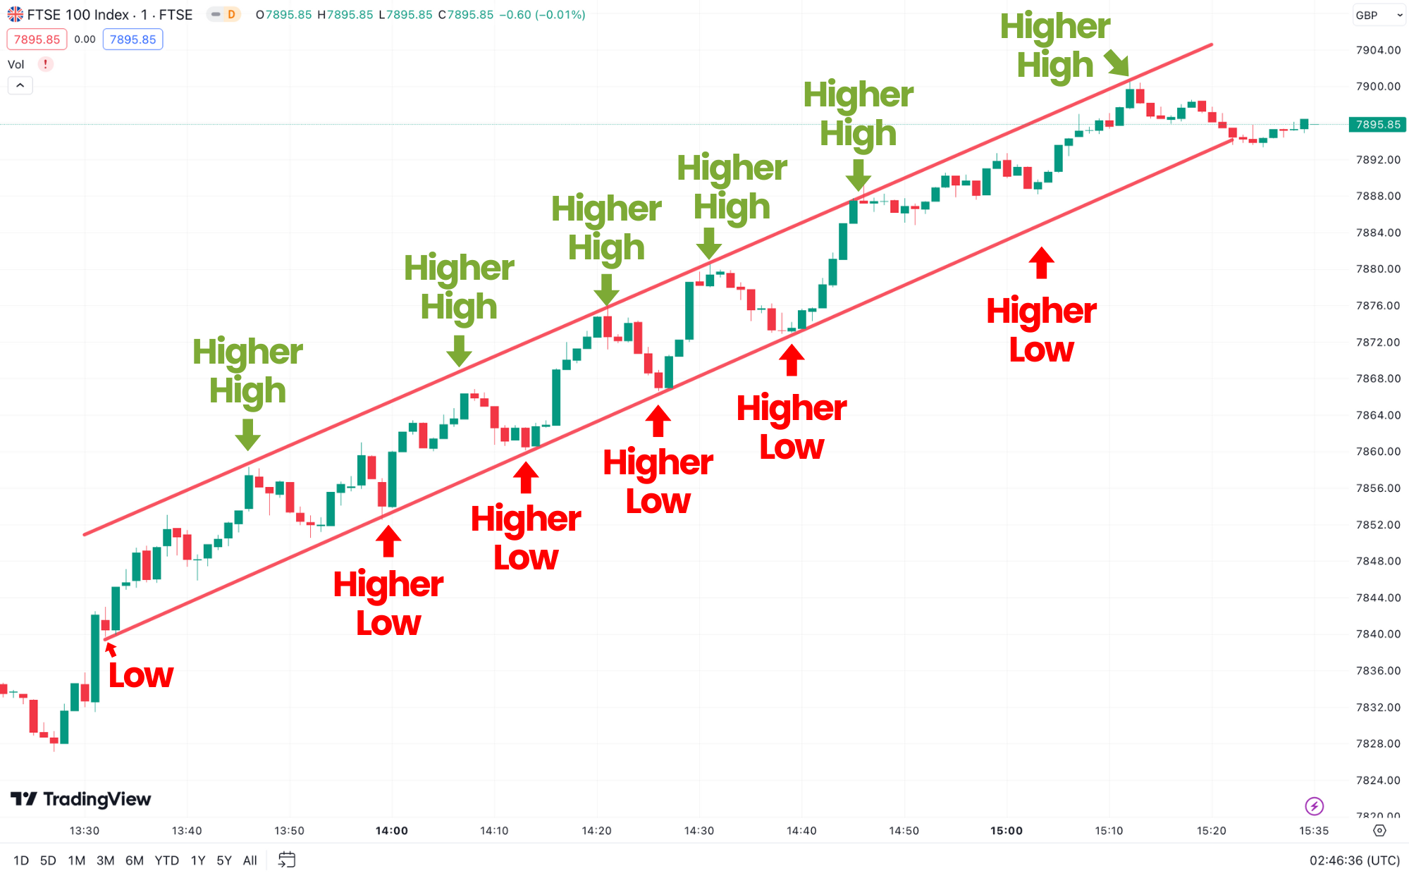
Uptrend
An uptrend is marked by an overall increase in price.
Often an up-trend is represented in the form of a sequence of higher highs and higher lows. .
While the trend is up, traders focus on buying, attempting to profit from a continued price rise.

Slide 17
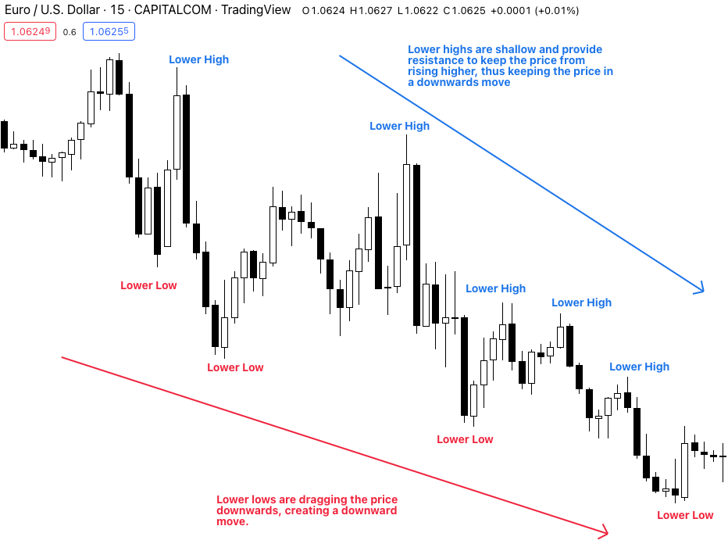
Downtrend
Once the upward trend starts to break down, it turns into a downtrend.
Downtrends are composed of lower swing lows and lower swing highs.
When the trend turns down, traders focus more on selling or shorting, attempting to minimize losses or profit from the price decline.

Slide 18
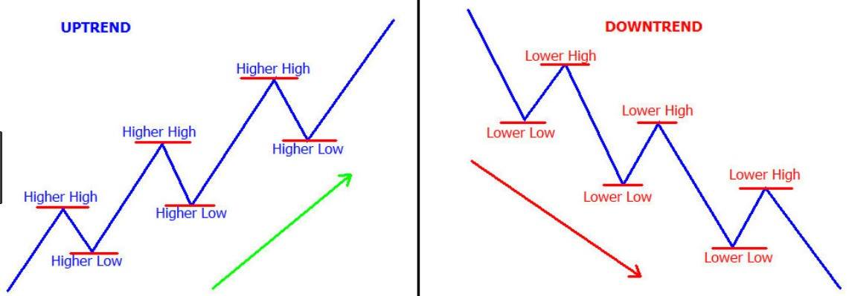
TREND

Slide 19
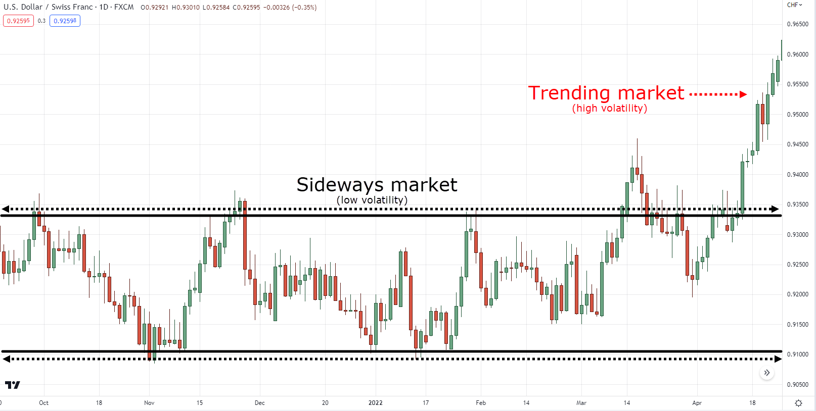
Range Bound Trend / Consolidation
It is also known as sideways trend.
A sideways trend is the horizontal price movement of a stock between resistance and support levels that occurs when the forces of supply and demand are balanced.

Slide 20
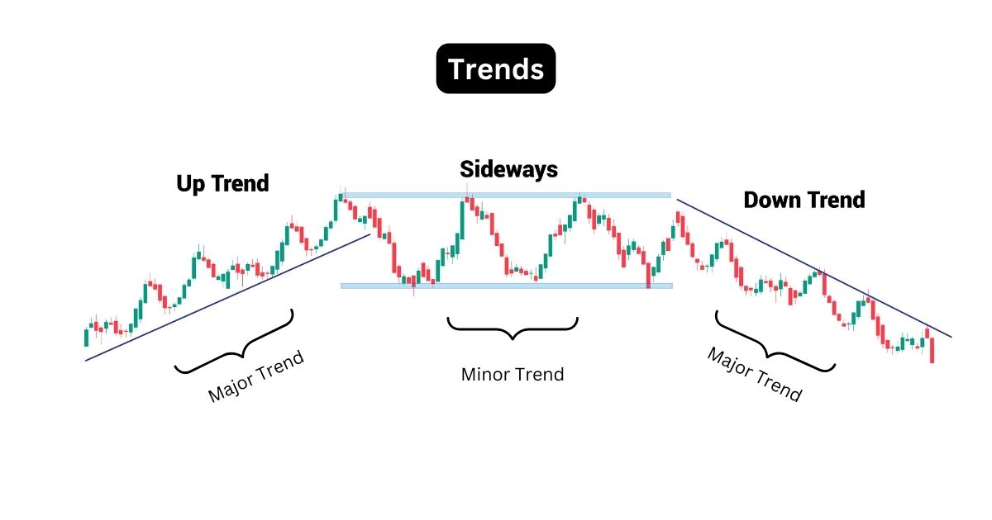
Example

Slide 21
Dow Theory
Charles Dow, the grandfather of technical analysis, propounded what is popularly known as Dow theory.
Dow theory is based on the assumption that stock market does not move on random basis rather there are set trends which can detect the direction of market movement.
According to this theory in any type of market; whether bullish or bearish, three trends are simultaneously at work - the primary trend, the intermediate trend and the minor trend.

Slide 22
Dow Theory
Primary trend is the long term trend over a period lasting for more than one year. This trend sets the overall direction of the market. If primary trend is upward then bull market is in operation whereas if primary trend is downward then the market is bearish.
Intermediate trend, on the other hand lasts for a few months and operate in the opposite direction of primary trend. If the primary trend is upward then intermediate trend will be downward movement and vice versa. Therefore intermediate trends are also known as “secondary corrections”.
Tertiary or minor trends are day-to-day or intra-day fluctuations in stock market which do not last for long. These trends provide no meaningful conclusion regarding the overall market movement and hence are given least importance.

Slide 23
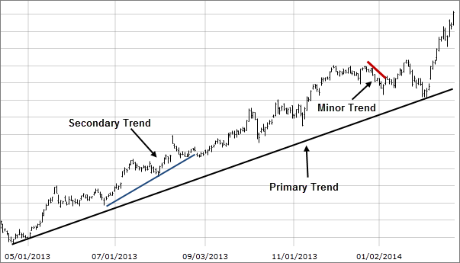
Primary Vs. Secondary Vs. Minor Trends

Slide 24
Chart Patterns
Patterns are the distinctive formations created by the movements of security prices on a chart and are the foundation of technical analysis.
A pattern is identified by a line connecting common price points, such as closing prices or highs or lows, during a specific period.
Technical analysts and chartists seek to identify patterns to anticipate the future direction of a security’s price.
These patterns can be as simple as trendlines and as complex as double head-and-shoulders formations.

Slide 25
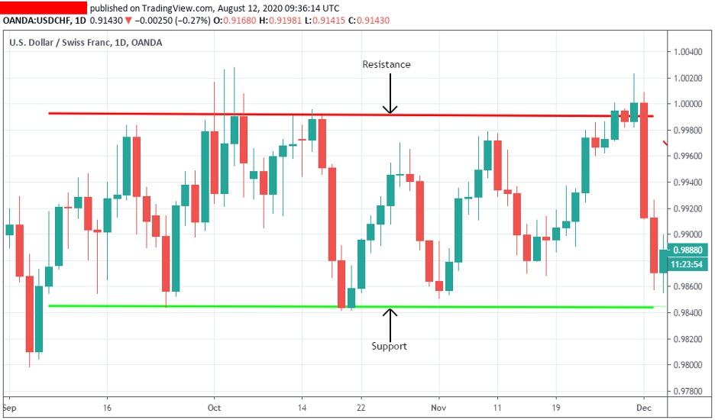
Support and Resistance
Support level is that price, below which the price is not expected to fall.
Resistance level is that price, above which the price does not go.
For example, if the SBI share price have been moving in the range of Rs. 2000 to Rs. 3000 for long. Then Rs 2000 may be considered as its Support level (or support price) and Rs. 3000 as its Resistance level(or resistance price).
Hence if a stock’s price approaches its support level, it is a good buy opportunity. If a stock’s price reaches its resistance level, it provides a good opportunity to sell.

Slide 26
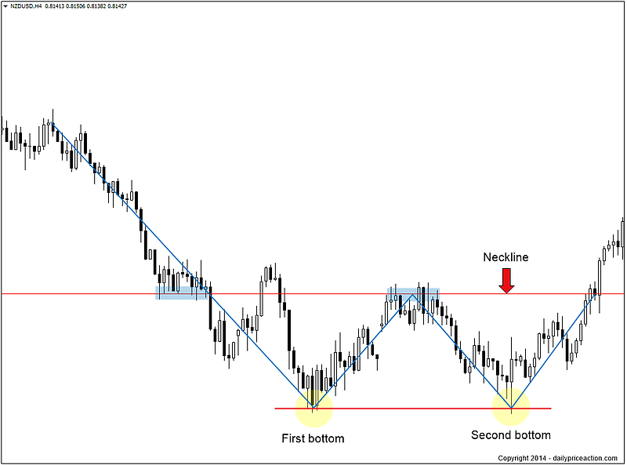
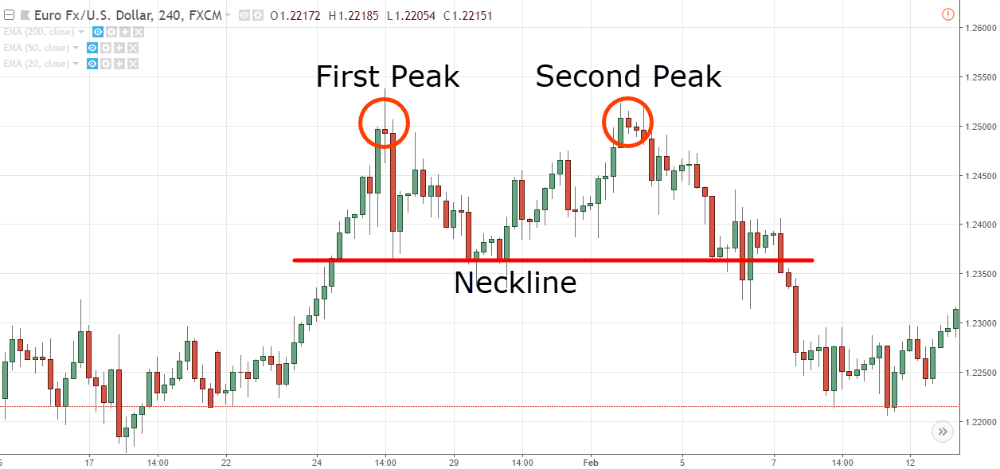
Double Tops and Bottoms
Double Bottom
Looks like W shape
Two bottom shows the support level for the stock.
This is a sign of trend reversal from downtrend to uptrend when the price crosses the neckline.
Double Top
Looks like M shape
Two Tops shows the resistance level for the stock.
This is a sign of trend reversal from uptrend to downtrend when the price crosses the neckline.

Slide 27
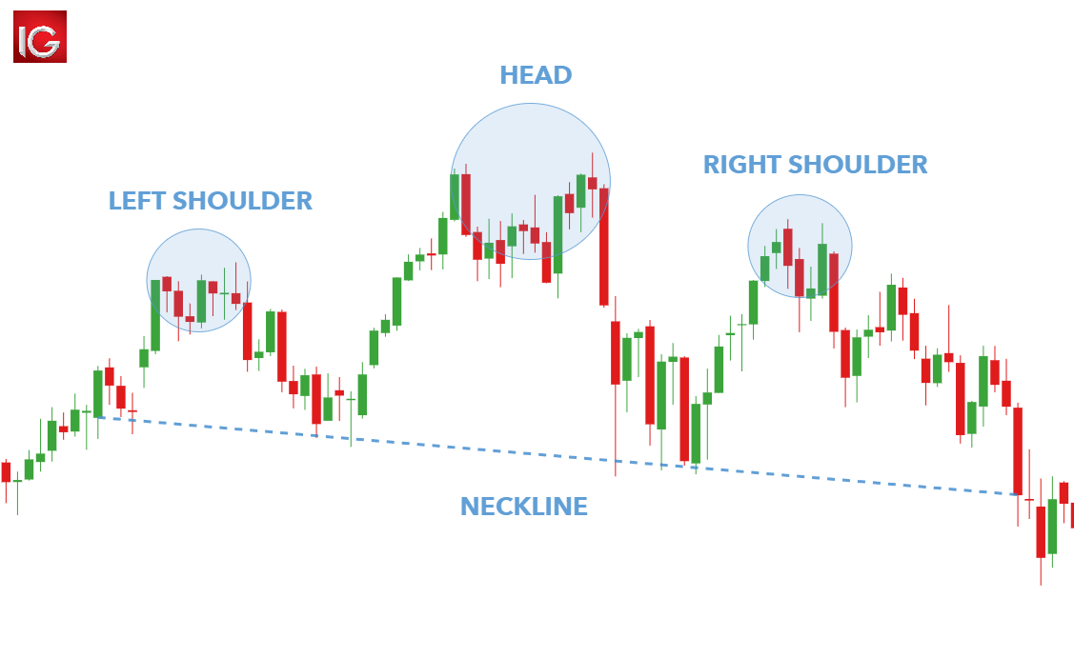
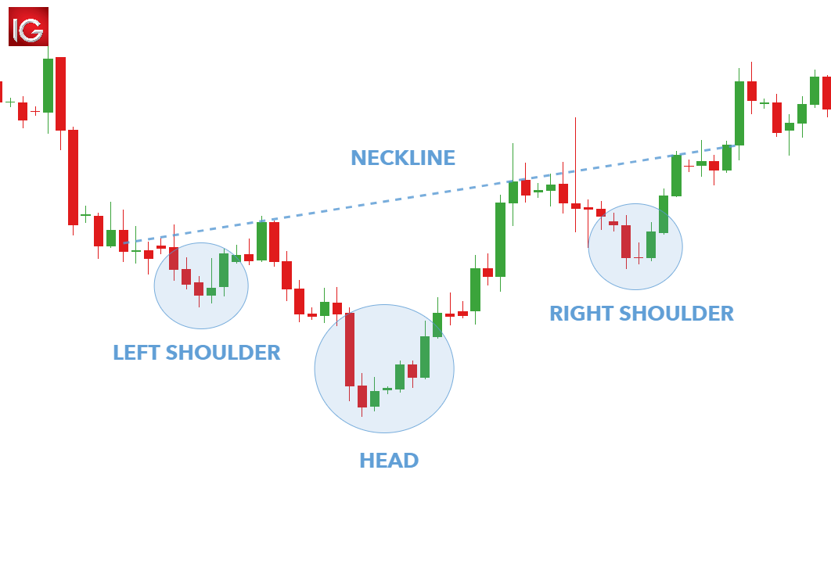
Head and Shoulder Pattern
Head and shoulder
If the stock price goes below the neckline, indicates bearish phase & hence sell signal
Inverted Head and Shoulder
If stock prices rises above the neck -line, indicates bullish phase for the stock & hence buy signal

Slide 28
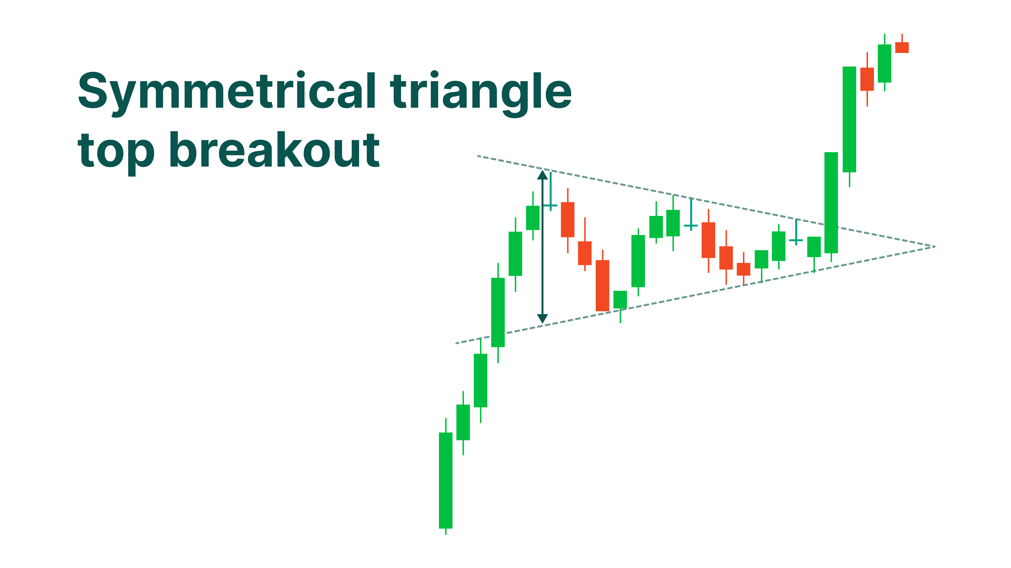
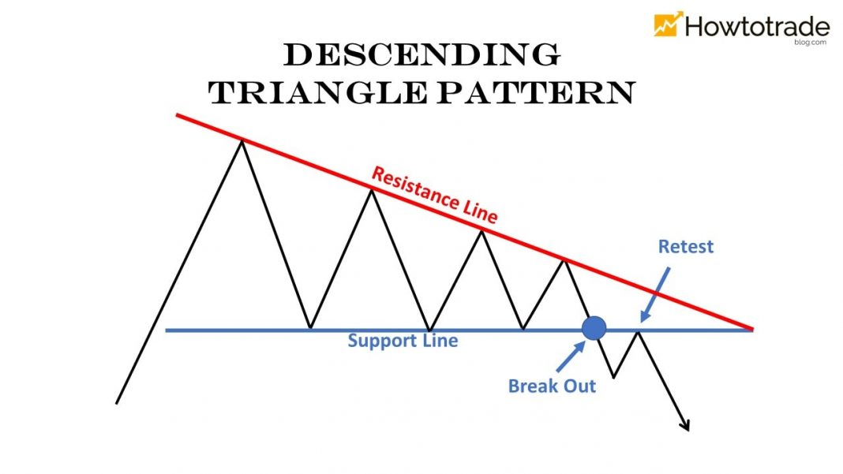
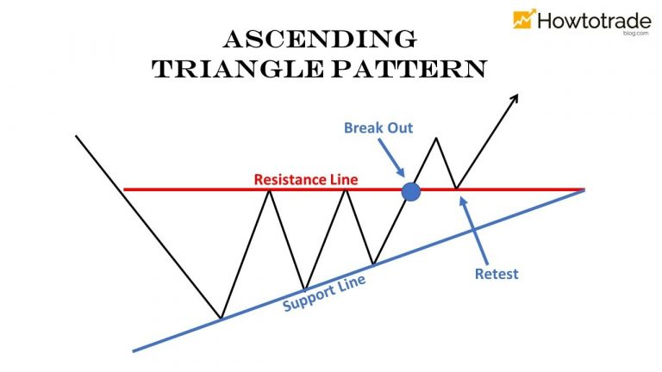
Triangle Patterns
Triangles
Symmetrical Triangle – suggest a range bound market till it is complete.
Descending Triangle – if it breaks towards below, implies price decline in near future and hence suggests a sell signal.
Ascending Triangle – if it breaks towards above, suggests a bull run in near future or buy signal

Slide 29
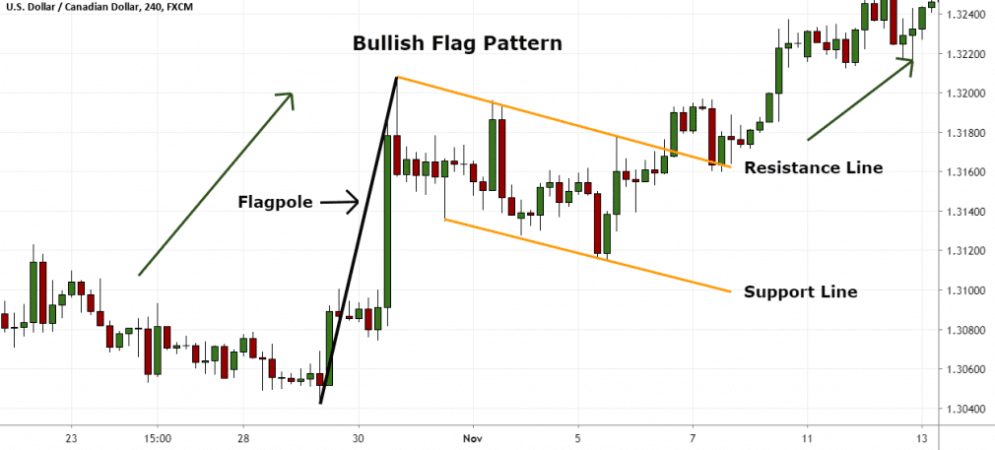
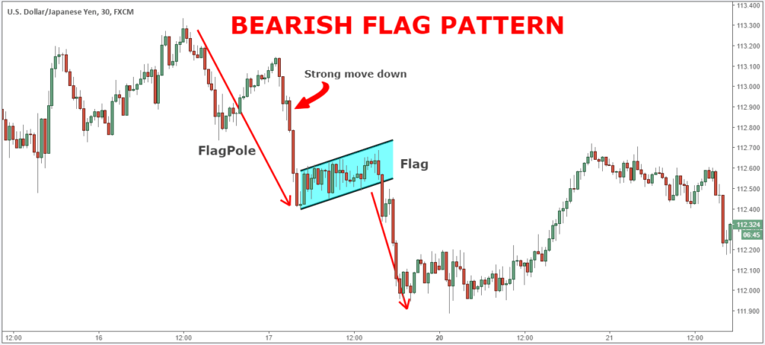
Flag Patterns
Triangles
A flag chart pattern is detected when a bull rally or bear phase enters into a consolidation pattern which appears as a rectangle or parallelogram.
The consolidation phase forms the ‘flag’ for a continuing trend.
It is predicted that after the consolidation phase is over, the stock price will move in the same direction in which they were moving before the formation of flag pattern.

Slide 30
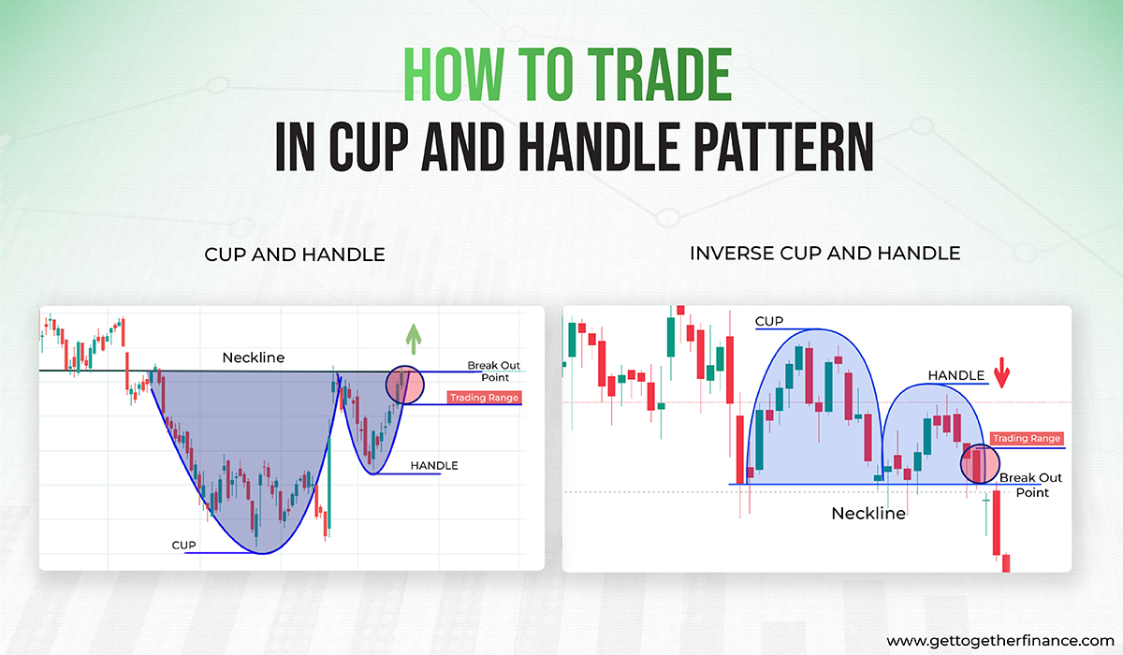
Cup and Handle Patterns
It is similar to the actual shape of the cup and handle, and traders use it as a reliable breakout trading strategy.
Traders anticipate the pattern completion with a strong up-move and trade accordingly at the breakout point.
It is considered an excellent bullish signal when used in accordance with demand and supply pattern.

Slide 31
Market Indicators
Market Indicators are tools to aid decision making in the market.
There are various types of indicators which measures or indicate the trend, the momentum, the volatility and various other aspects in the market.
There are thousands of indicators which are derived out of the price and volume data over time.
Here we introduce you with four very useful indicators.

Slide 32
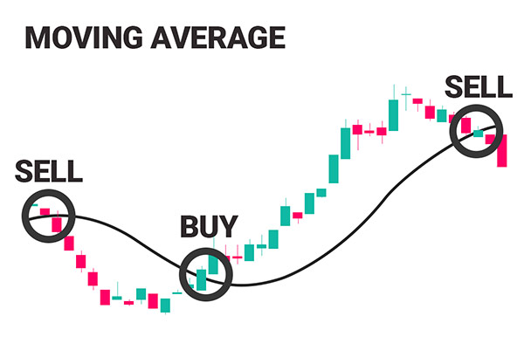
Moving Averages
Moving average (MA) is a statistical technique to find out average of a series on rolling basis.
MA can be used to analyse the movement of the entire market as well as individual stock prices.
200 days or 52 weeks MA are most popular in the analysis of overall market trend.
The 200 days MA is one of the most reliable and easily understandable technical indicators available to technical analysts and investors.

Slide 33
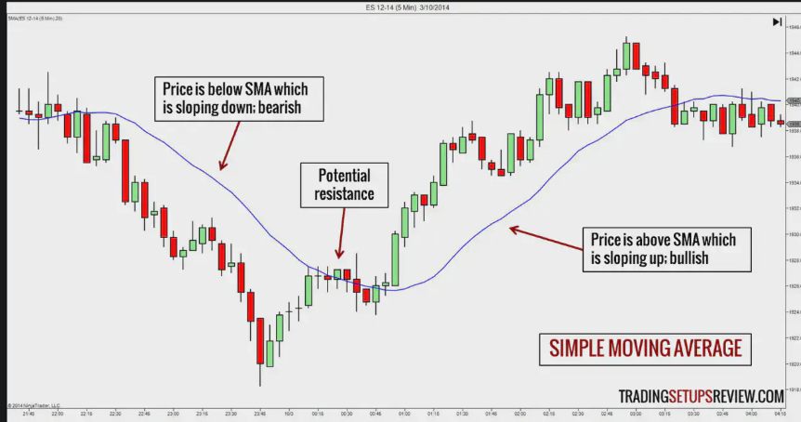
Moving Averages

Slide 34
Relative Strength Index (RSI)
Relative Strength Index (RSI) is a momentum oscillator, developed by J. Welles Wilder, which measures the speed and velocity of price movement of trading instruments (stocks, commodity futures, bonds, forex etc.) over a specified period of time.
The objective of RSI indicator is to measure the change in price momentum.
It is a leading indicator and is widely used by Technical Analysts.
RSI can be used to spot a general trend.
It is considered overbought when it goes above 70 and oversold when it goes below 30.
30-70 region of RSI is considered to be normal zone.

Slide 35
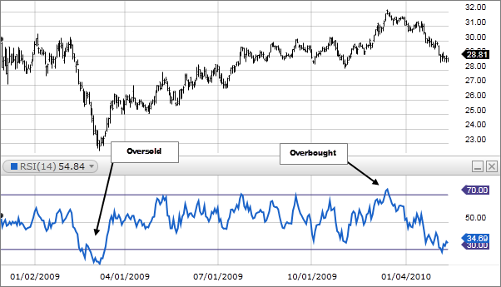
Relative Strength Index

Slide 36
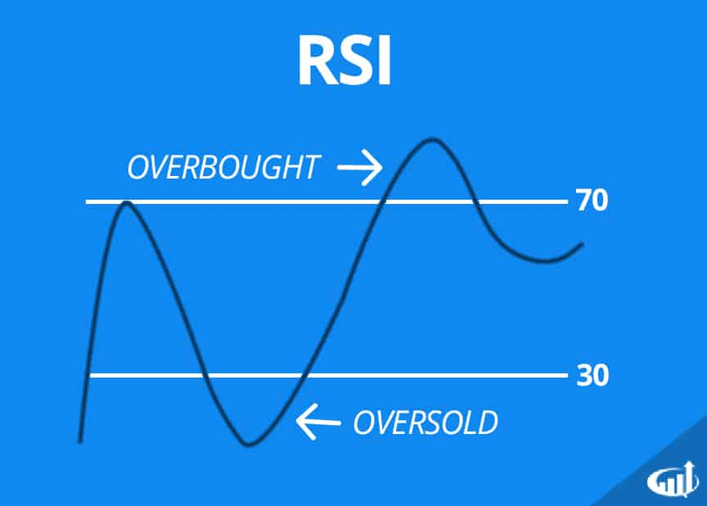
Indicators
RSI

Slide 37
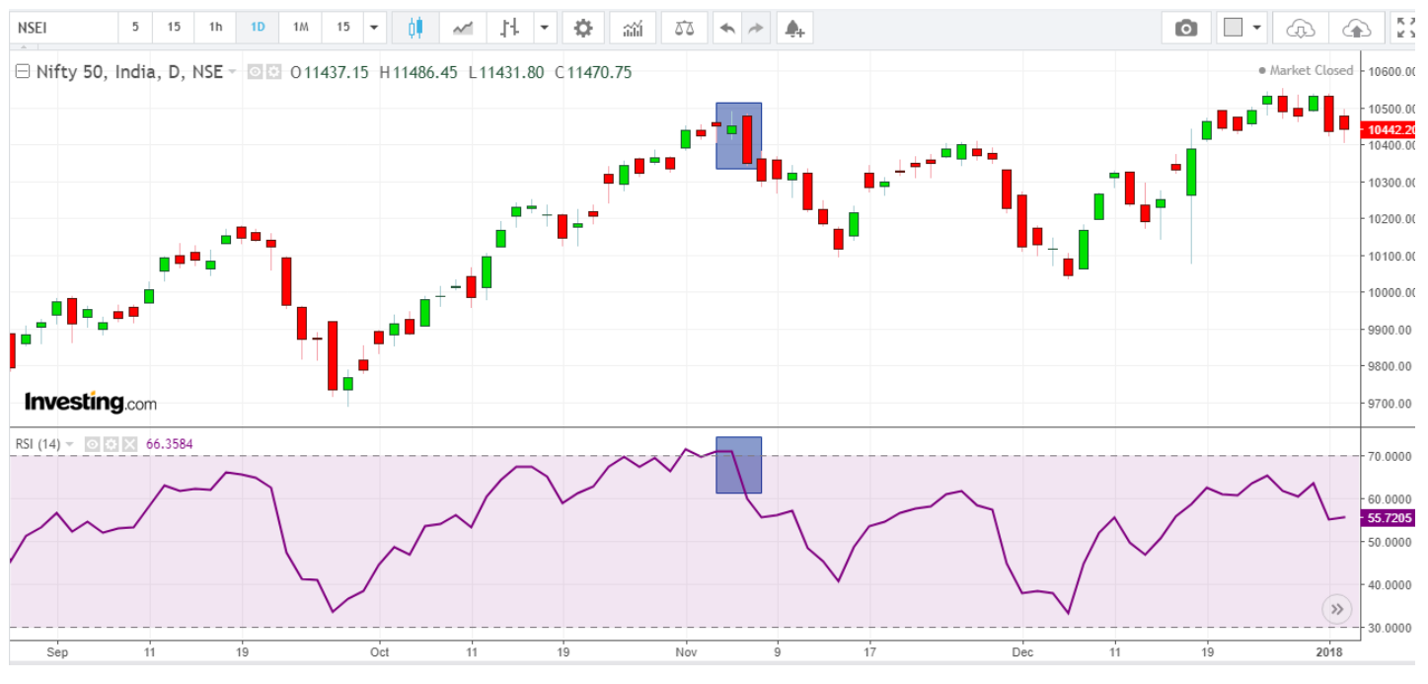
Relative Strength Index (RSI)
Usage:
There are many kinds of usage of RSI. However most popularly, if we find that, RSI breaching the 70 level and at the same time we spot a bearish reversal pattern, then there is opportunity to take short trade with stop loss. Similarly if RSI breaches 30 from below and we observe a bullish reversal pattern, there is opportunity to take long trade with stop loss.

Slide 38
Bollinger Band
Bollinger Bands is a technical analysis tool used to determine where prices are high and low relative to each other.
These bands are composed of three lines: a simple moving average (the middle band) and an upper and lower band.
The upper and lower bands are typically two standard deviations above or below a 20-period simple moving average (SMA).
The bands widen and narrow as the volatility of the underlying asset changes.

Slide 39
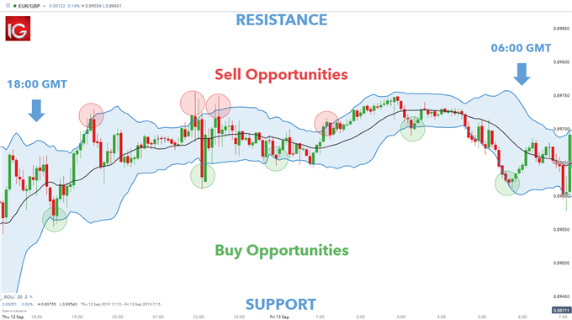
Bollinger Band

Slide 40
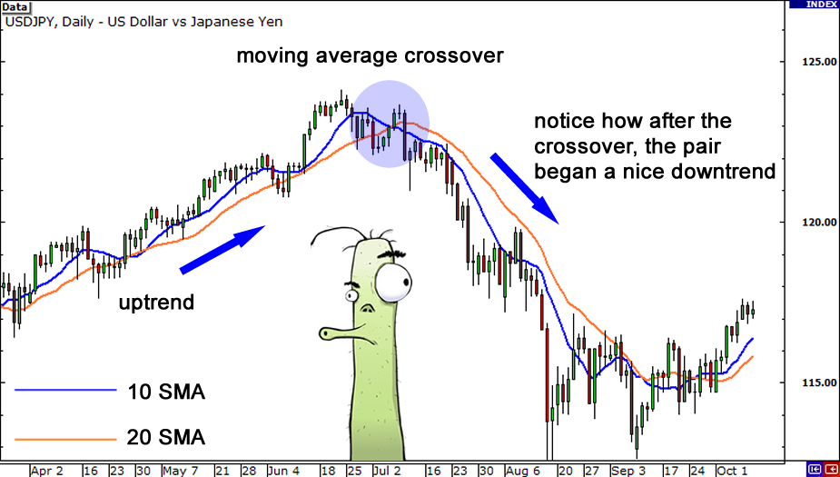
Moving Average Crossover
Moving average crossovers are a common way traders can use Moving Averages.
A crossover occurs when a faster Moving Average (i.e. a shorter period Moving Average) crosses either above a slower Moving Average (i.e. a longer period Moving Average) which is considered a bullish crossover or below which is considered a bearish crossover.

Slide 41
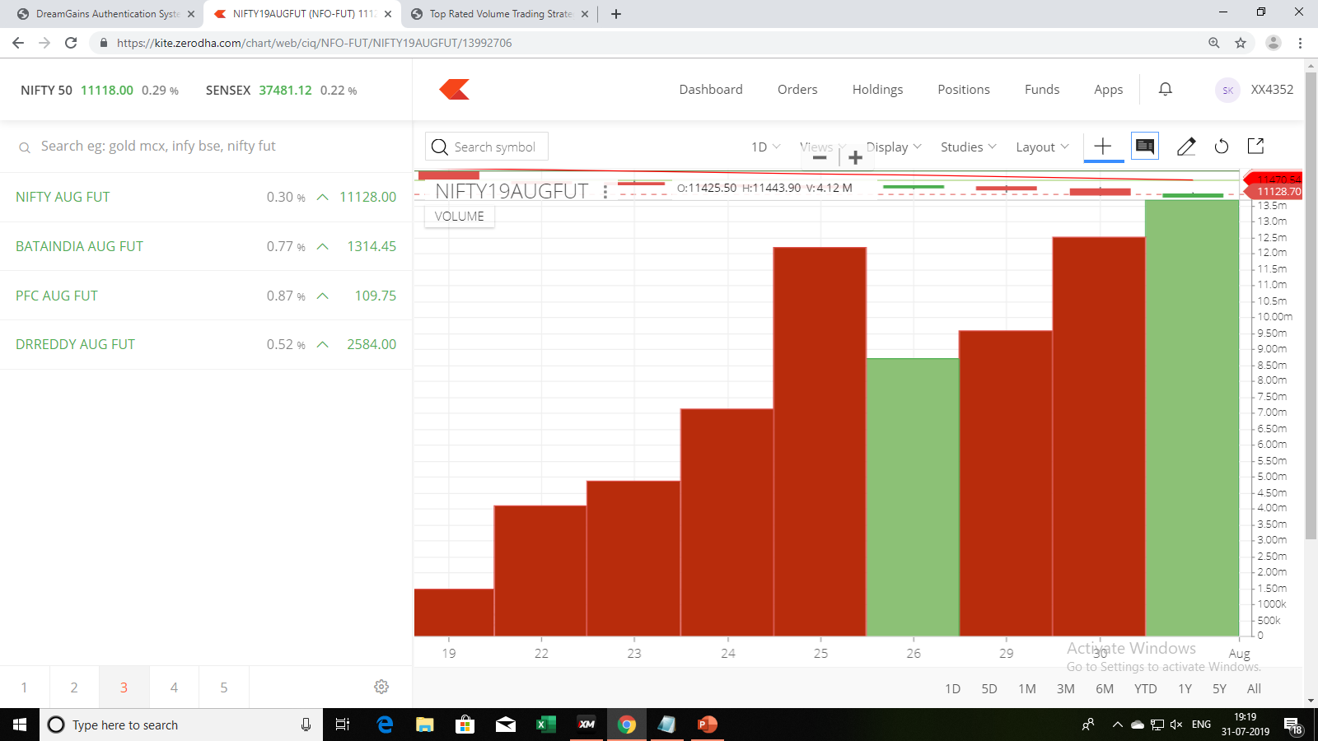
Volume Indicator
All the chart patterns and indicators discussed so far, used only past price data for stocks.
However stock’s past volume data also provides useful insights into and hence can be used in predicting stock prices.
In technical analysis, volume measures the number of a stock's shares that are traded on a stock exchange in a day or a period of time.
Volume is important because it confirms trend directions.

Slide 42
Volume Indicator
Most trading platforms, print each volume bar as either green or red.
Green bars are printed if the stock closes up for a period and red bars indicate a stock closed lower for a given period.
Researchers have observed that –
Rising volume in bullish market is further bullish.
Declining volume in bullish market suggests that market will turn bearish in near future.
Rising volume in bearish market farther strengthens the bearish trend.
Declining volume in bearish market suggests that market will turn bullish in near future.

Slide 43
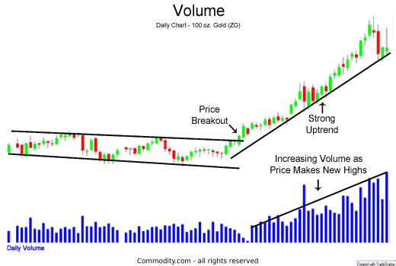
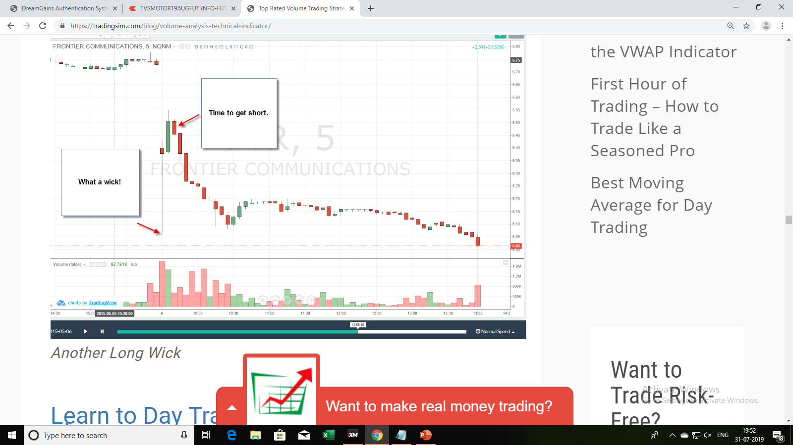
Volume Indicator

Slide 44
Limitations of Technical Analysis
Requirement of Interpretational skills : Various charts and patterns of technical analysis requires careful interpretation by skilled analysts. Hence technical tools and indicators may not be used widely by common investors.
Subjective analysis and Behavioural biases : Technical analysts, are subject to many behavioural biases while interpreting various chart patterns and predicting future stock prices based on the analysis of past price data. Some of these behavioural biases are- over-confidence, framing, regret avoidance and so on.
Late response to a chart pattern : Once a chart pattern is detected, it needs to be acted upon immediately. Hence the technical analyst must be a quick identifier of a chart pattern to make gains out of it. In practice, such a quickness or promptness is rarely observed.
Short term perspective : The perspective of a chartist is short term and hence long term predictions are generally not based on technical tools and techniques. For long term analysis, fundamental analysis is a better approach to find out the real worth of a share

Slide 45
Technical Analysis Vs. Fundamental Analysis
Which is superior? - Technical analysis or Fundamental analysis
There has always been a debate between fundamental analysts and technical analysts to show their supremacy.
It must be noted that Fundamental analysis and Technical analysis are not mutually exclusive. They are complementary.
Technical analysis complements fundamental analysis to identify the right time to buy or sell the security which is suggested by fundamental analysis.
While fundamental analysis calculates the intrinsic value of a share using EIC framework, technical analysis predicts future price movements using past price and volume data.
The perspective in case of Fundamental analysis is long term while in case of Technical analysis, short term.
Hence Fundamental analysis is considered superior to Technical analysis when an investor has a long term investment horizon.
Technical analysis on the other hand is preferred by short term traders and speculators.

Slide 46
RISK MANAGEMENT Some key principles to trade stock market
Always know when to enter and where to exit.
Use stop loss.
Average only when in profit never in loss.
Following the herd is the common reason to loss money.
Don’t trade multiple market instead trade single market with diversifications.

Slide 47

Namaskar & Thank You

